Slide 1
FSW-T100
Telescopic trolley stand for
touch screens
© Audipack

Slide 2
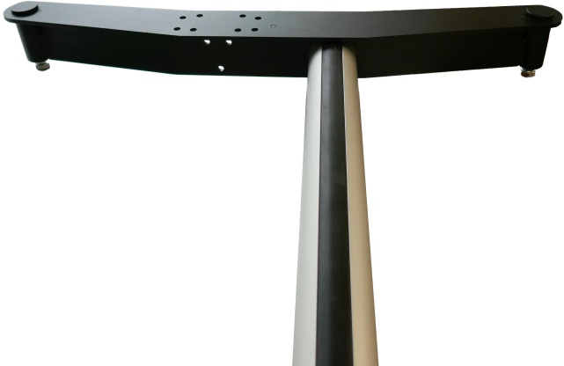
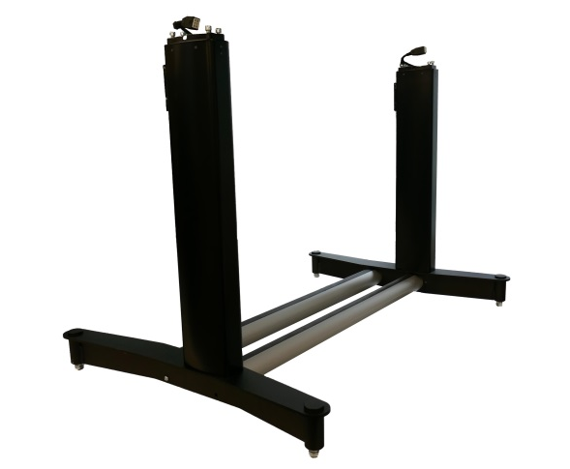
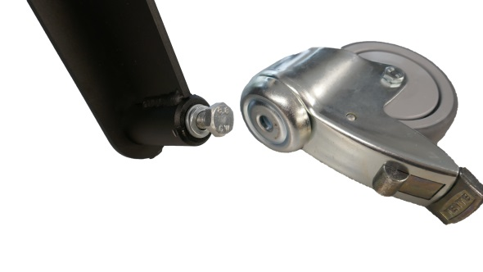
The FSW-T100 is an electric trolley stand suitable for (touch)monitors up to 100kg.
1.
The FSW-T100 comes as an unassembled product.
Install the two aluminum 54 mm tubes between the wheel frames.
Make sure that the wheel frame is bended outwards.
Install the 2 tubes with corresponding bolts between the wheel frame.
2.
Install the two lift columns with the corresponding bolts on top of the wheel frame. Make sure that the cables are on the top of the column.
3.
Add the 4 wheels to the wheel frame with the corresponding bolts.
© Audipack

Slide 3
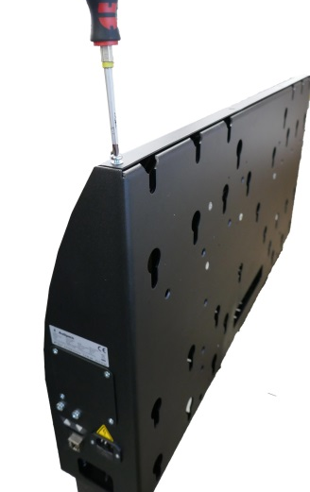
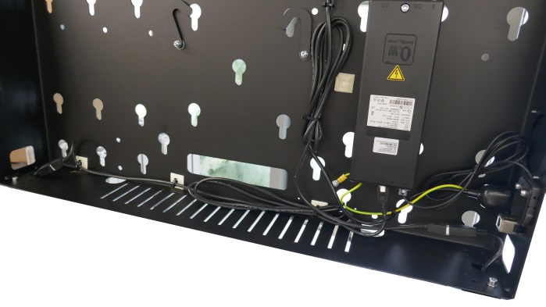
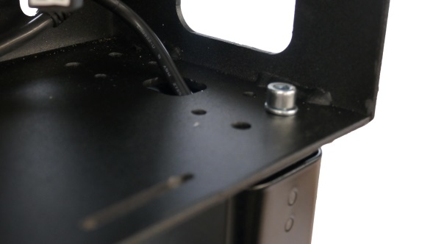
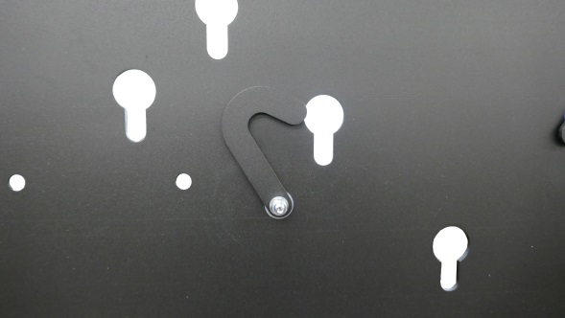
4.
To install the cabinet on top of the lift columns, first remove the back plate by removing the screws on topside. Use the corresponding bolts, to install the cabinet. Guide the motor cables to the power supply and connect them.
5.
If the monitor is attached with the cams to the cabinet, Use the hook to lock and secure on the inside.
6.
Reattach the back plate by using the corresponding screws.
© Audipack

Slide 4
Audipack's general conditions of sales and delivery apply to all of Audipack's deliveries. These conditions can be downloaded from Audipack's website, www.audipack.com, or will be sent by post on request.
Audipack liefert ausschließlich unter die allgemeine Verkauf- und Lieferungsbedingungen von Audipack. Diese Bedingungen sind zum downloaden verfügbar auf die Webseite von Audipack, www.audipack.com, oder werden Ihnen auf Anfrage per Post gesendet.
Alle leveringen geschieden uitsluitend volgens de Algemene Verkoop- en Leveringsvoorwaarden van Audipack. Een afschrift hiervan kunt u downloaden van de website van Audipack, www.audipack.com, of wordt u op aanvraag gestuurd per post.
Les conditions de vente et de livraison de Audipack s'appliquent à tous les livraisons de Audipack. Cette conditions sont disponible sur le site internet de Audipack, www.audipack.com, où seront envoyé par poste sur demande.
AUDIPACK
Industriestraat 2-4
2751 GT Moerkapelle
the Netherlands
Tel: +31(0)795931671
Fax: +31(0)795933115
Email: audipack@audipack.com
www.audipack.com
Audipack reserves the right to make changes in specifications and other information contained in this document without prior written notice. The information provided herein is subject to change without notice. In no event shall Audipack be liable for any incidental, special, indirect, or consequential damages whatsoever, including but not limited to lost profits, arising out of or related to this manual or the information contained herein, even if Audipack has been advised of, known, or should have known, the possibility of such damages.
© Audipack

